Slide 1




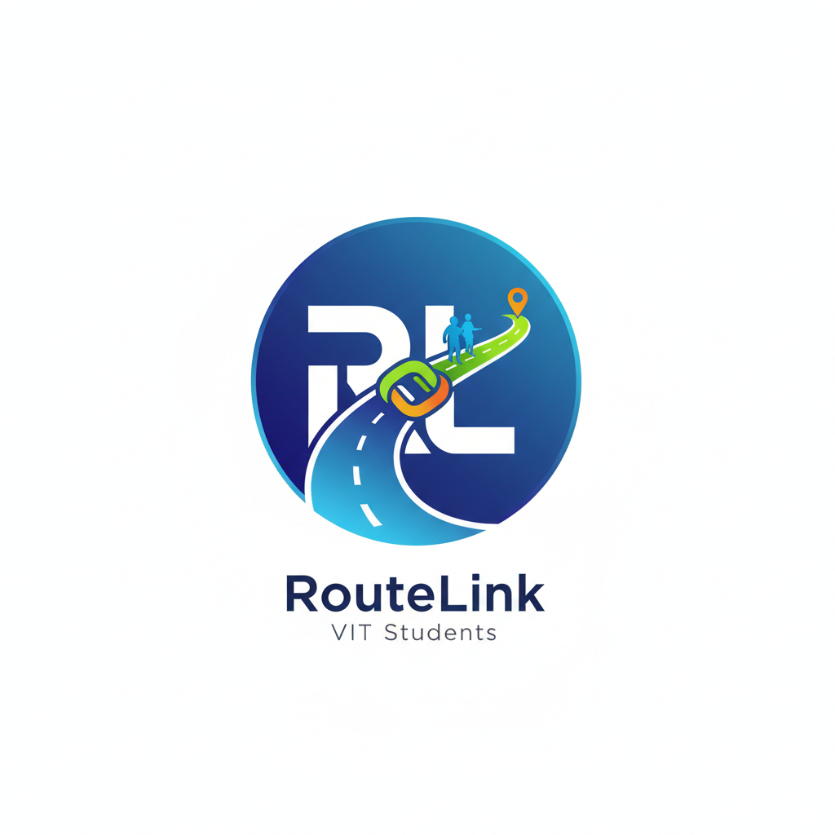


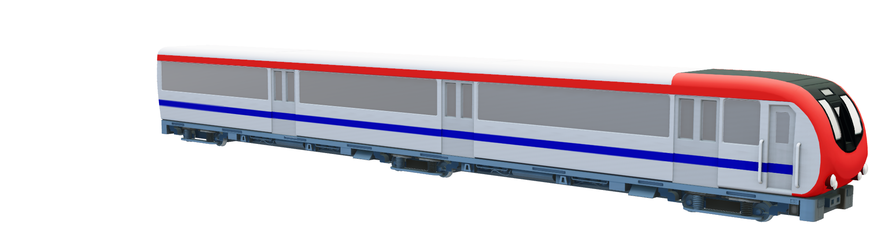
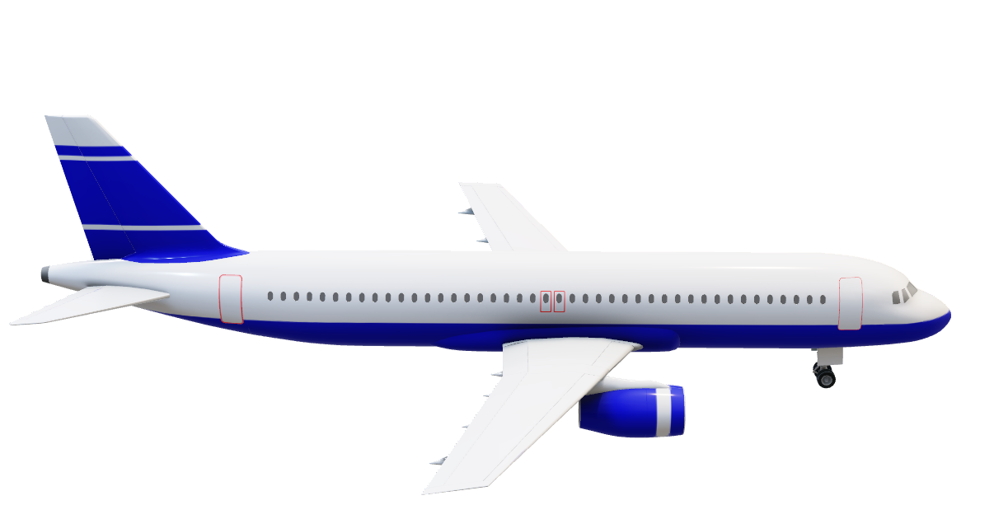
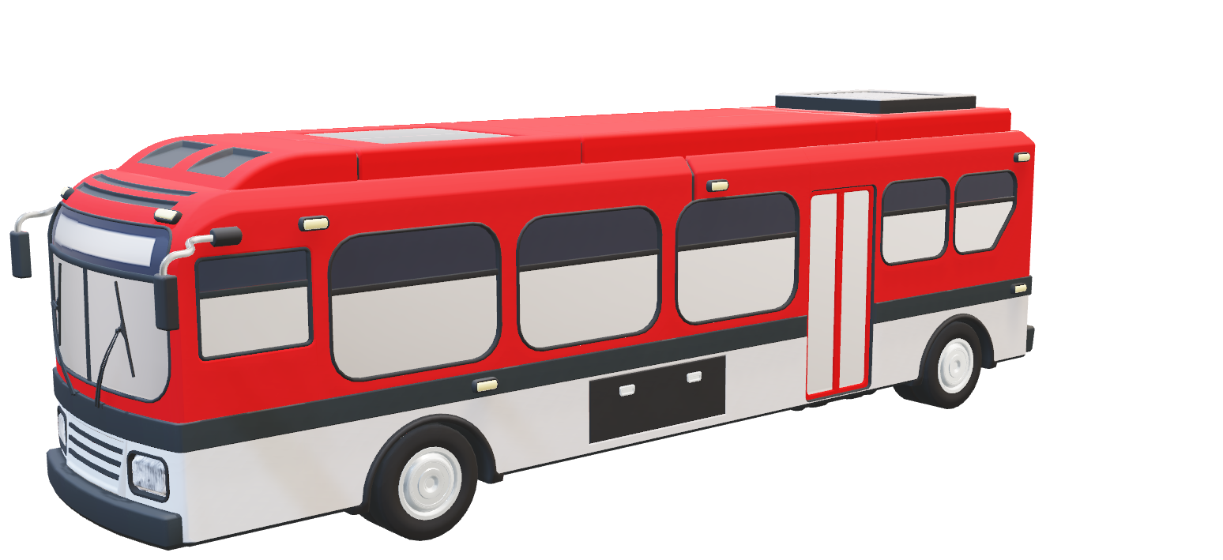
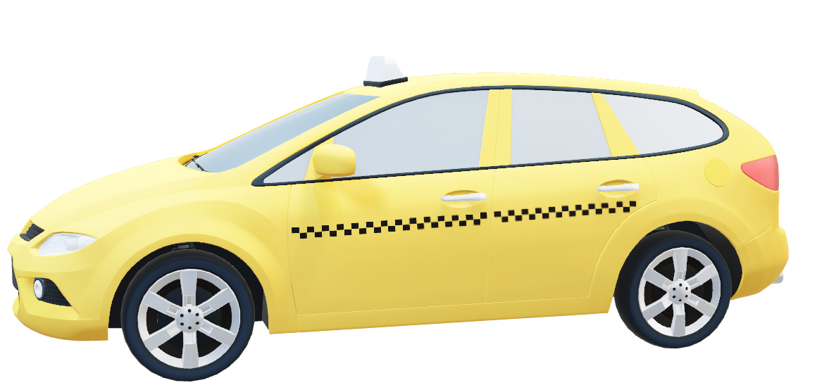
"Every Link Counts. Every Route Matters."

Slide 2



RouteLink
Group Name: InnoJam
GROUP MEMBERS:-
B. NIKITHA
ANURADHA PRADEEP
ANUSHKA SHIVRAM K.
KAUSHAKI BILGRAMI

Slide 3
PROBLEM STATEMENT
Students often struggle with planning and coordinating travel during college life. Vacations, weekend getaways, and trips home are usually planned at the last minute, making it difficult to find travel companions. This results in higher costs, safety concerns, and unnecessary stress. While existing ride-sharing or travel apps exist, none are tailored to the unique schedules of students or integrated with their academic calendars and timetables.
PROPOSED SOLUTION
Route Link is a student-focused travel-connection platform designed to simplify and personalize the way students organize travel. By integrating academic calendars and personal timetables, it allows students to plan trips in advance, match with others heading in the same direction, and coordinate journeys seamlessly. The system creates a safe, community-based environment restricted to VIT students.

Slide 4
Key Features
1. Calendar Integration
Calendar is built in so students can easily view major holidays and weekends to plan their trip accordingly .
2. Travel Planning
Students input destination, date, and time along with the type of transport.
A calendar-based system shows who else is traveling on the same day.
3. Profiles and Verification
Student-only access (VIT community).
Profiles display name, year, branch, and photo for familiarity and trust.
4. Group Coordination
If multiple students share a route, the app allows group creation for easy planning.
Reduces costs by enabling shared cabs, rides, or other transport.
5. Safety and Accessibility
Community-limited access ensures safety.
Simple UI focused on student needs rather than generic travel features.
We have also added a filter so that we can choose who to contact.

Slide 5
RouteLink
Register
Sign-in

Slide 6
Choose Date:
OCTOBER
MON | TUE | WED | THUR | FRI | SAT | SUN
 |  | 1 | 2 | 3 | 4 | 5
6 | 7 | 8 | 9 | 10 | 11 | 12
13 | 14 | 15 | 16 | 17 | 18 | 19
20 | 21 | 22 | 23 | 24 | 25 | 26
27 | 28 | 29 | 30 | 31

Slide 7
Route Details:
People details
Slot No.
End Point
Major Stops
No. of people
.
Time
Transport Type
Link
to
the
Rout
e
Add Slot
View slot

Slide 8
Link Details:
People details
Name
Drop
Ph no.
Course year
Branch
Link
to
the
Add Link

Slide 9
Target Audience
Primary: VIT students who frequently travel home, to nearby cities, or on vacations during holidays.
Secondary: Potential expansion to other universities and student communities.
Impact
Makes travel planning less stressful and more organized.
Reduces costs by enabling ride-sharing.
Improves safety by restricting the platform to verified students.
Encourages efficient use of time by integrating with academic schedules.
Future Scope
Expansion to multiple universities.
AI-based travel suggestions (e.g., best days to travel, cheapest options).
Partnerships with cab, bus, or railway booking platforms.
In-app payments for shared rides.

